Slide 1
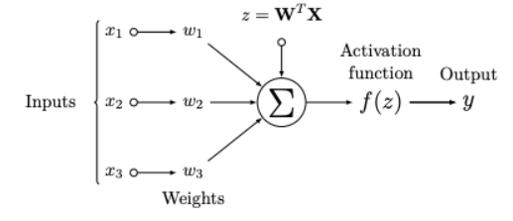
Activation Function
An Activation Function decides whether a neuron should be activated or not.
It decide whether the neuron's input to the network is important or not in the process of prediction using simpler mathematical operations.

Slide 2
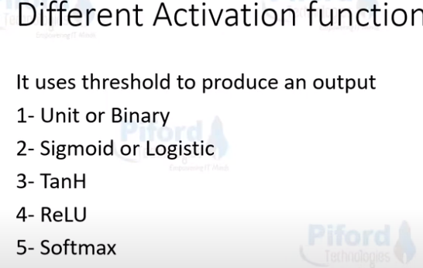
https://www.youtube.com/watch?v=QBHj9xoPy_o
https://www.youtube.com/watch?v=QBHj9xoPy_o

Slide 3
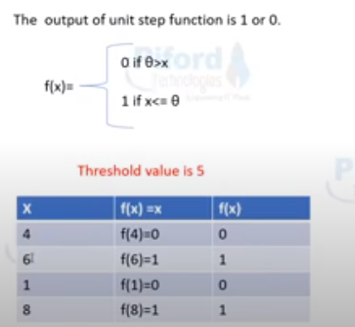
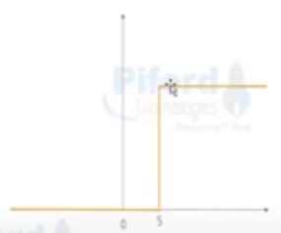

Slide 4
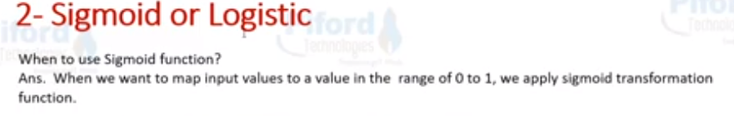

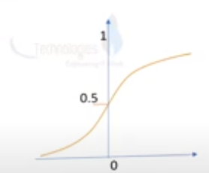
x | f(x) = x | f(x)
1 | f(1) = 0.73 | 0.73
10 | f(10) = 0.99 | 0.99
100 | f(100) = 1 | 1
-1 | f(-1) = 0.268 | 0.268
-10 | f(-10) = 4.539 | 4.539
-100 | f(-100) = 3.720 | 3.720
Input can span between – infinity to + infinity

Slide 5
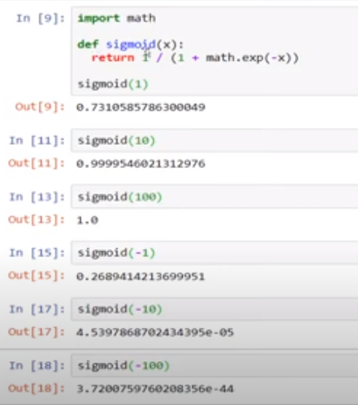

Slide 6



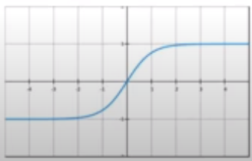
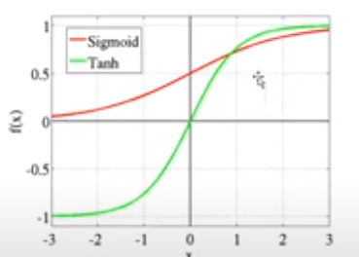
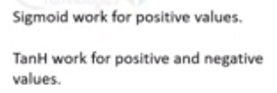
x | f(x) = x | f(x)
-4 | f(-4) = -1 | -1
-2 | f(-2) = -0.7 | -0.7
2 | f(2) = 0.7 | 0.7
4 | f(4) = 1 | 1

Slide 7
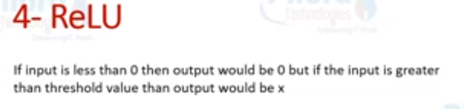
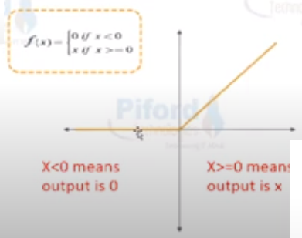
x | f(x) = x | f(x)
-3 | f(-3) = 0 | 0
-5 | f(-5) = 0 | 0
3 | f(3) = 3 | 3
5 | f(5) = 5 | 3

Slide 8

X | Class A | Class B | Class C | Class D
1 | 0.97 | 0.1 | 0.1 | 0.1
11 | 0.3 | 0.3 | 0.91 | 0.3
23 | 0.2 | 0.94 | 0.2 | 0.2
9 | 0.3 | 0.1 | 0.5 | 0.1

